Slide 1
Test AQP_gui_wBranchTrunk_CnsdHelps

Slide 2
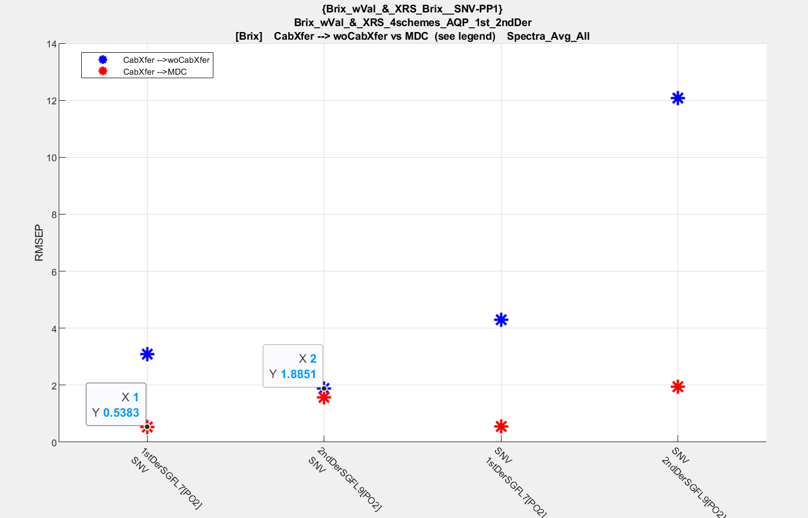

Slide 8
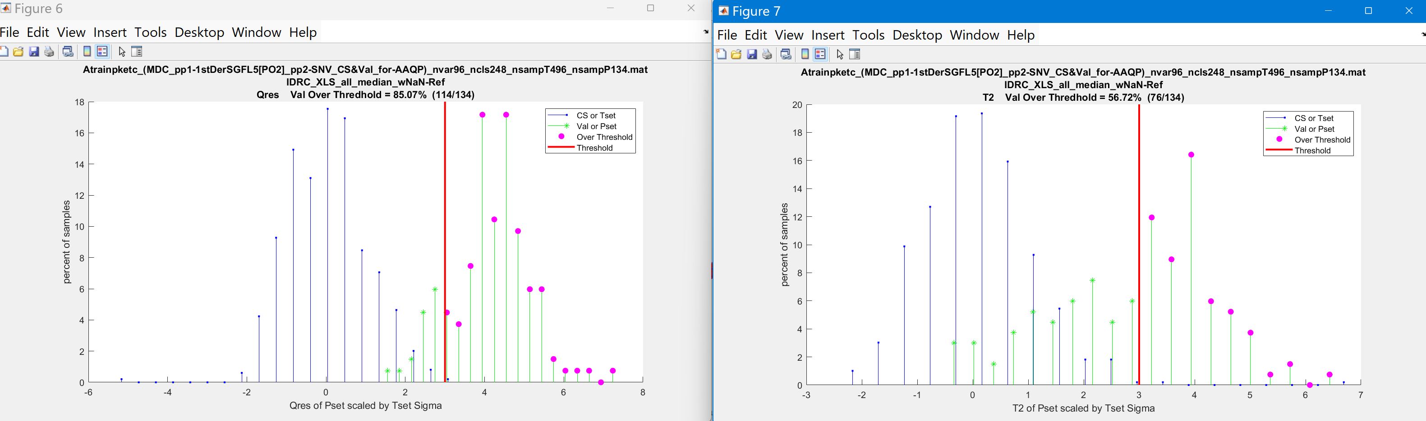

Slide 10
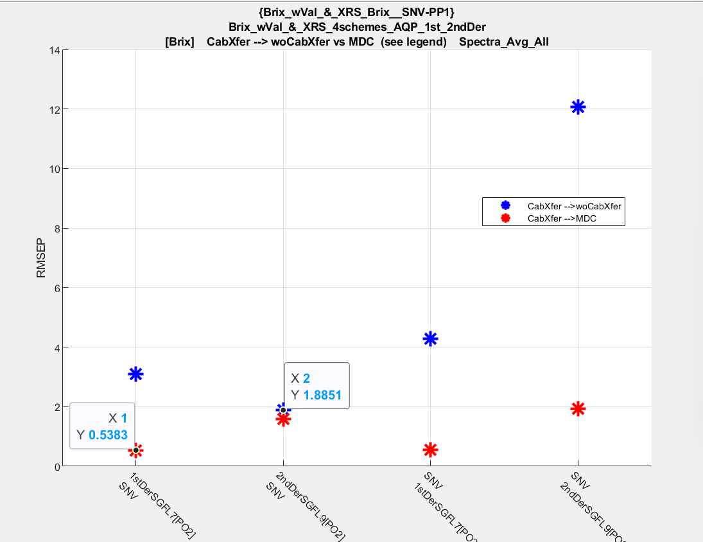
AQP_gui_merged

Slide 12
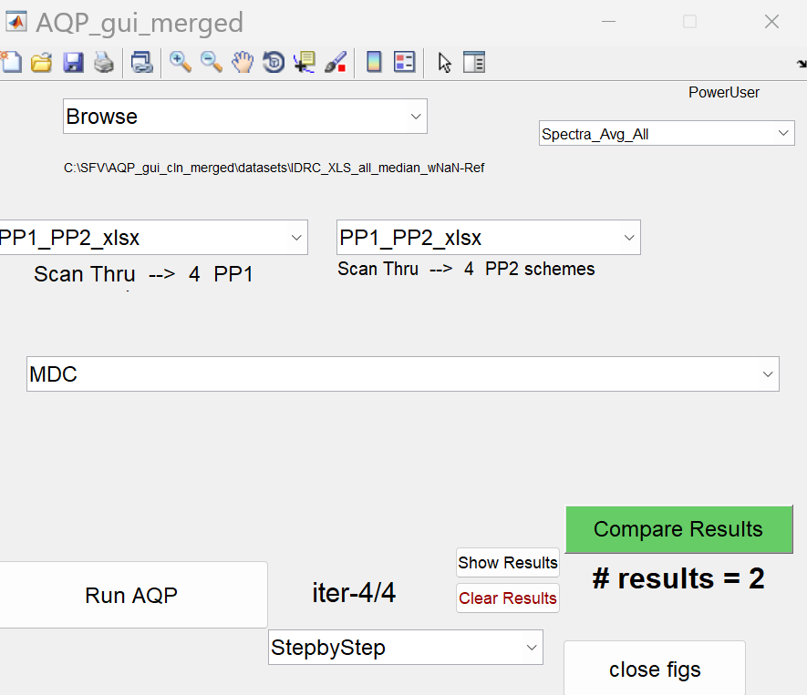
AQP_gui_merged

